Slide 1
Chemical Safety Information Management and Reporting at the University of California
Presented by: Phillip Painter
University of California Office of the President
Chemical Informatics Center of Excellence
08/16/17

Slide 2
Outline
Purpose
Reporting expectations (CERS)
Stakeholders
What have we done?
Difficulties encountered (So far)?
How can a Mixture InChI (MInChI) help?
Notes:
Family grouping – across manufacturers as well as within individual manufacturers
(Stabilizers – reporting and experimental concerns)

Slide 3

Purpose
Main = Satisfy OSH Act & EPCRA Obligations
  http://cers.calepa.ca.gov/
California Certified Unified Program Agency
Department of Toxic Substances Control
(DTSC)
Environmental Protection Agency
(CalEPA)
Office of Emergency Services
(Cal OES)
Office of the State Fire Marshal
(Cal Fire)
State Water Resources Control Board
(SWRCB)
Data Has Added Value in Other Areas:
  Hazard Assessment
  Use/Approval Authorization(s)
  IT Application Data Validation
Notes:
Why do we need a robust inventory?
Federal and local reporting,
OSH Act = ‘Worker Right to Know’
Emergency Planning and Community Right to know Act = ‘Community Right to Know” – result of Bhopal, India, 10K deaths from release of methyl isocyanate
Hazard Assessment includes applications to Signage, MAQs, PPE Requirements, etc….

Slide 4
Reporting Expectations - CERS
Physical State
Radioactivity & Waste Details
Quantity Info
Storage Container Details
  Type
  Storage conditions
Hazardous Component(s)
  Five most abundant species
  Wt. %
USEPA Registry Number
DOT Hazard Class
Location
Chemical
  Name
  Trade Secret/EHS status
  CAS number
  Common Name
Fire Code Hazard
HazMat Type
Notes:
What type of information do we need to gather to satisfy CERS report? Have to understand an intended use in order to understand what data needs to be gathered.
Location = Building and/or GPS coordinates
EHS = Extremely Hazardous Substance as defined by 40 CFR Part 355
Quantity = Average and Maximum amounts (annual basis), Units must be in Pounds, Gallons or Cubic Feet
Component Data Fields include Name, EHS status, CAS number

Slide 5
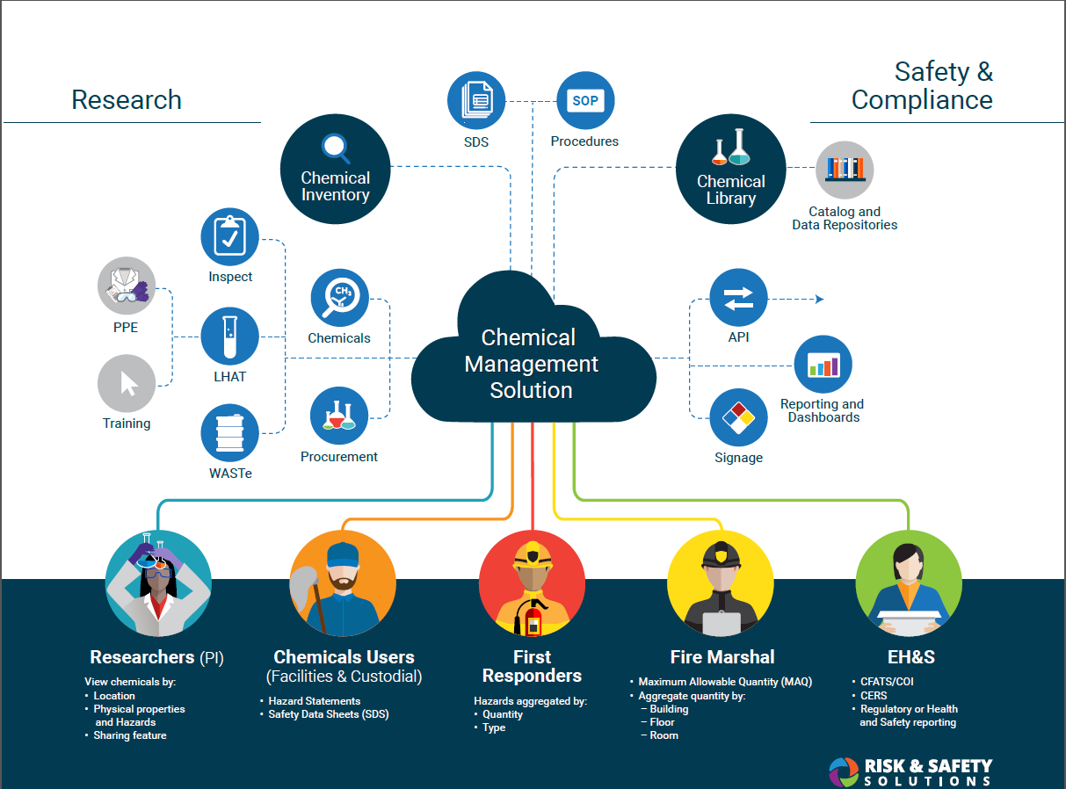
Notes:
Different Uses – Different expectations
Large number of Stakeholders,
Huge number of potential applications – not just limited to Reporting

Slide 6
Stakeholders
Where is it?
Does anyone else have any?
How do I use this safely?
What protections do I need?
How much is in an a space?
Who has it?
Notes:
Need to understand the intended users in order to understand their intended uses of the application.
How they intend to use it affects what they expect to see.
Additional users, but these are the main groups and help frame the use case

Slide 7

What was our approach?
User inputs: Location, Physical State, Quantity Info, Container Type, Storage Conditions
Chemical information is searched and connected to the container by the user
Notes:
Gather as much information as possible from user
Chemical information like physical properties and hazards are stored in a “Chemical Library” and the User makes the initial connection of information
Integration with purchasing could remove the human element – by vendor product #

Slide 8
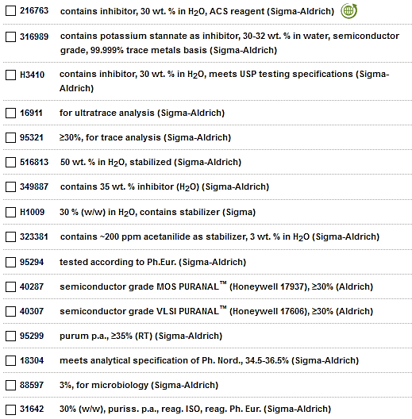
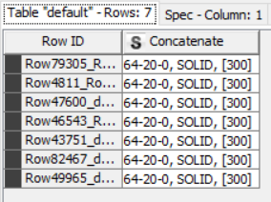
“Chemical Library”: Programmatic grouping
Vendor Catalog (Products)
CAS, Physical State, Hazard Codes
https://www.knime.org/
Notes:
“Chemical Library” – vendor product #s to resolve exact identity, many different products (how to call something the same?)
Based on Reporting (similar hazards, inventoried similarly)
Programmatic fingerprinting (CAS, physical state, Hazards) – (Not name!)
Idea – Unified information within and across vendors (Mind the gap!)
Vendors sell multiple products for a variety of reasons – not just 1 bottle of acetone.
Needed to look for similarities in the data, most reliable for our use case were CAS, physical state, and hazards. – name not so much (butyl lithium -400 different ways)
Supplemented by manual curation
MInChI could help streamline this process either by supplementing or replacing

Slide 9
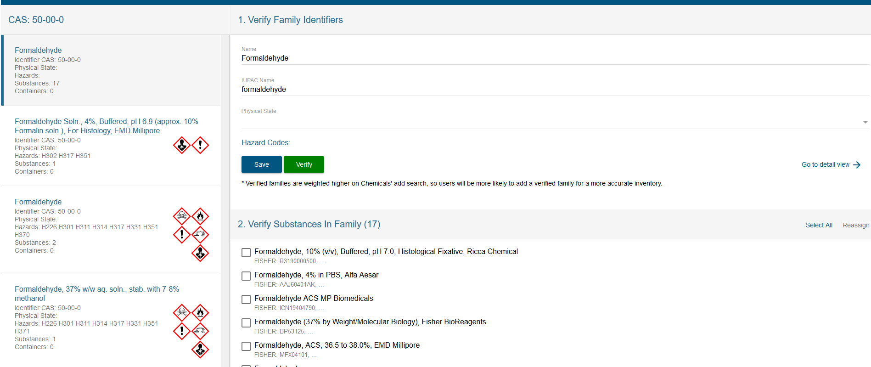
“Chemical Library”: SME Curation
Notes:
GUI to supplement/manually curate programmatic suggestions (validate and curate)
Did the proposed groups ‘make chemical sense’
Left: “Programmatic Groupings”
Middle top: “Data entry”
Middle bottom: “Disaggregate/aggregate”

Slide 10



Lessons Learned
Mapping of External Databases time intensive (unstructured data)
No (global) unique identifiers
Differing Stakeholder viewpoints
Can of Paint
Color
Vendor?
Notes:
Ontologies: way of grouping and describing relationships between materials.
Multiple ways of storing data, lack of unique identifier – previous example of butyl lithium names
Ex. Hydrogen peroxide solutions earlier.
-Should/Can Salts of a material show up in the same group?
-I have 30 cans of paint, why do you care what color or vendor it is (Should there be 1 entry for Paint, X for ___ colored paint, or 1 entry for each product and each manufacturer combination? (Record creep – corresponding data implications)

Slide 11
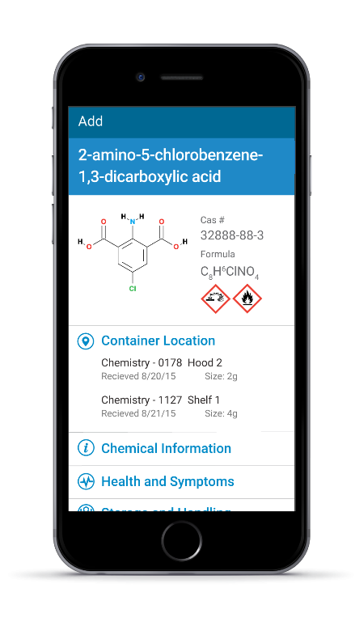
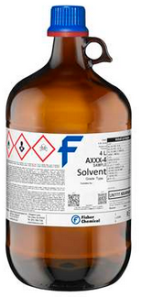
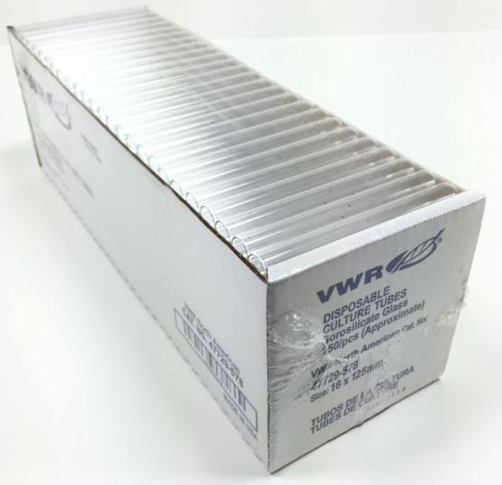
Practicality: Must Add Value
Ease of Access
High turnover items
Lab supplies
Mobile
Solvent
Culture Tubes/ Lab Supplies
Notes:
Mobile : Huge in increasing adoption of program, almost everyone has a smart phone and apps, capitalize on the swiss army knife nature of smartphones
Thereby increases likelihood user will use the inventory program, and maintain accurate information – rather than just once a year when required. – Accuracy of these inventories and the subsequent reporting
High turnover items like Solvent – User does not want to barcode each bottle – added time to workflow
Solution – barcoding a location and denoting how much is typically there, challenge is now don’t know how much is used in a given time without additional data from Purchasing
Quantity: 1000 bug report – Huh? 1 box or 1000 tubes. Should this be inventoried? (Give a mouse a cookie)

Slide 12
How can a Mixture InChI help?
Unify data across databases and vendors
Increase accuracy of container identification
Decrease manual curation workload
Notes:
While MInChI won’t solve 100% of our use case, it will address a large %.
Accuracy and workload of curation

Slide 13
External Collaborators
American Chemical Society
  Division of Chemical Health and Safety
  Division of Chemical Information
Cornell University
Keene State
Millipore-Sigma
National Institute of Health (PubChem)
SciQuest
ThermoFisher Scientific
U.S. Environmental Protection Agency (CompTox)

Slide 14
Questions?

Slide 15
Contact Us
Email: pppainter@ucdavis.edu
cajakober@ucdavis.edu
website http://www.ucop.edu/enterprise-risk-management/resources/centers-of-excellence/chemical-informatics.html
Phone: (530) 752-7194

